Slide 1

Intro to CSS
Inventor: Hakon Wium Lie

Slide 2
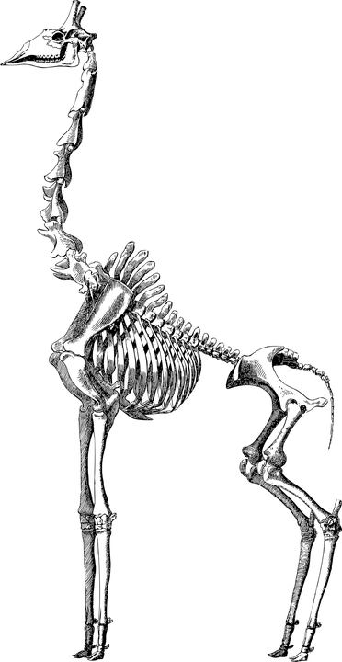
CSS provides style
Try turning CSS off in your Browser and see what the internet looks like!
A bit like seeing an animal with no flesh and fur!
Chrome: There’s actually no setting in Chrome to disable CSS, so we have to resort to an extension, like disable-HTML.
Firefox: View > Page Style > No Style
Safari: Safari > Preferences... > Show Develop menu in menu bar. Then go to the Develop dropdown and select the “Disable Styles” option.
Opera: Like Chrome, we need an extension, and Web Developer fits the bill.
Internet Explorer 11: View > Style > No style

Slide 3
Three ways of Adding CSS
Inline - <h1 style=”color:red;”>Hello World!</h1>
Internal (in the <head> section) - <style>h1{color:red;}</style>
External - using a <link> tag to connect to a css file e.g style.css

Slide 4
Your Turn (file 1)
Open a new HTML file and style some h1 or p html tags using the following method:
<h1 style=”color:red;”>Hello World!</h1>
<p style=”color:green;”>Hello World!</p>

Slide 5
CSS Properties
A css property determines what part of the tag is to be styled there are lots of properties.
E.g some examples for text:
color, font-size, font-family, font-style, text-align, text-shadow
Checkout CSS Text and CSS Fonts for just some methods of styling
In your repl project try to add more css properties to your modified h1 and p tags

Slide 6
CSS Values
A css value determines what the property will be set to
E.g color:#ffffff is font color white
Sizes are often in pixels px or percentages %

Slide 7
DIV tags - html placeholders
Divs are used everywhere on all websites the provide a framework to hold all the other html tags.
The <div> element is a block-level element.
Read more about DIVS

Slide 8
A Div about Dublin (file2)
<div style="background-color:red;color:white;padding:20px;">
<h1>Dublin</h1>
<p>Dublin is the capital city of Ireland. It is the most populous city in the Ireland, with a metropolitan area of approx 2 million inhabitants.</p>
</div>
Time for some PRIMM
Predict the Output, Run the Code, Investigate, Modify and Make your own

Slide 9
What other properties and values can you add to this?
<div style="background-color:red;color:white;padding:20px;">
<h1>Dublin</h1>
<p>Dublin is the capital city of Ireland. It is the most populous city in the Ireland, with a metropolitan area of approx 2 million inhabitants.</p>
</div>

Slide 10
So far we have only used INLINE css (file 3)
Internal CSS separates the CSS from the html tag, and instead we load the CSS in a <style> tag inside the <head> section
<head>
<style>h1{color:blue;}</style>
</head>
<h1>I am Blue</h1>

Slide 11
Task - Try some Inline (file4)
Remove your Internal CSS from your tags and put the code into the <style> tag in the <head>
Try the following inline CSS in the <head>
<style>
div{background-color:red;color:white;padding:40px;border:solid 3px black;margin:10px;}
</style>

Slide 12
Add the following HTML in the body
<div>
<h1>Dublin</h1>
<p>Dublin is the capital city of Ireland. It is the most populous city in the Ireland, with a metropolitan area of approx 2 million inhabitants.</p>
</div>
<div>
<h1>Berlin</h1>
<p>Berlin is the capital city of Germany. It is the most populous city in the Berlin, with a metropolitan area of approx 3.6 million inhabitants.</p>
</div>

Slide 13
Using Classes (file 5)
Unfortunately both divs are currently red. We can use CSS Classes to individually style the divs.
<style>
.dublin{background-color:green;color:white;padding:40px;border:solid 3px black;margin:10px;}
.berlin{background-color:red;color:white;padding:40px;border:solid 3px black;margin:10px;}
</style>

Slide 14
Update the HTML in the body (file 5)
<div class="dublin">
<h1>Dublin</h1>
<p>Dublin is the capital city of Ireland. It is the most populous city in the Ireland, with a metropolitan area of approx 2 million inhabitants.</p>
</div>
<div class="berlin">
<h1>Berlin</h1>
<p>Berlin is the capital city of Germany. It is the most populous city in the Berlin, with a metropolitan area of approx 3.6 million inhabitants.</p>
</div>

Slide 15
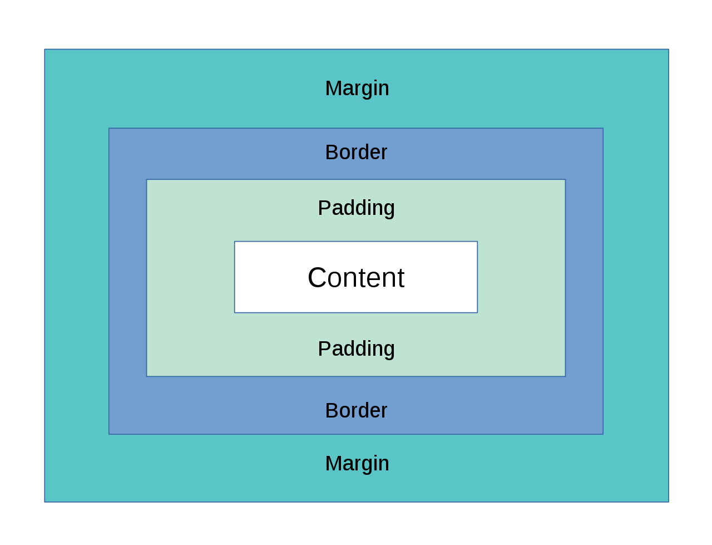
Investigate, Modify and Make
Play around with the values for each css property.
e.g
margin:
padding:
border:
Make sure you understand what’s happening.

Slide 16
External CSS - a Stylesheet (files 6)
Most websites use external stylesheets to load the css rules for the page.
This is more efficient (due to minimising technologies) and separates the css from the html code. This is known as SoC Separation of Concerns.
In repl a new html project has a file called style.css
In the <head> you can see the link tag linking to this file
<link href="style.css" rel="stylesheet" type="text/css" />
TASK:
Cut your CSS rules from your internal <style> tag and paste them into the style.css file. From now on you will add all new CSS rules to the

Slide 17
Check out more at w3schools
https://www.w3schools.com/css/default.asp

Slide 18
Try it out
Try out some of these CSS skills on the Café Website files located in folder 7.
I suggest using Internal styling for this. (Check out Examples 3, 4 & 5 to help)

